Slide 1

Department of Electrical & Electronics Engineering
SMART GUIDENCE FOR VISUALLY IMPAIRED PERSONS
MEMBERS:
Krishnamathi.C [19BEE004]
Sowndarya.K [19BEE028]
Vijaya sri.J [19BEE034]
GUIDED BY
Name: Dr.A.Senthilkumar
Designation: HOD/EEE

Slide 2
OBJECTIVE:
The main aim of this project is to support visually impaired persons.
This system guides visually impaired persons to reach their destination with the use of image decoding to audio.

Slide 3
FUNCTION:
In this project, we planned to develop the device that converts an image to speech.
It is implemented using a Raspberry Pi and a Raspberry Pi camera. The image captured by raspberry pi camera will continuously transmitts to raspberry pi module for decoding image as a audio information.
In this project we planned to create a code that plays pre-recorded audio when you crosses the common thing (E.g A building in front,bus moves towards/away,etc..) and gives a new audio output when you see the specified thing(E.g Traffic lights,sign board,etc…)
Comparatively low cost than the available products in the market.

Slide 4
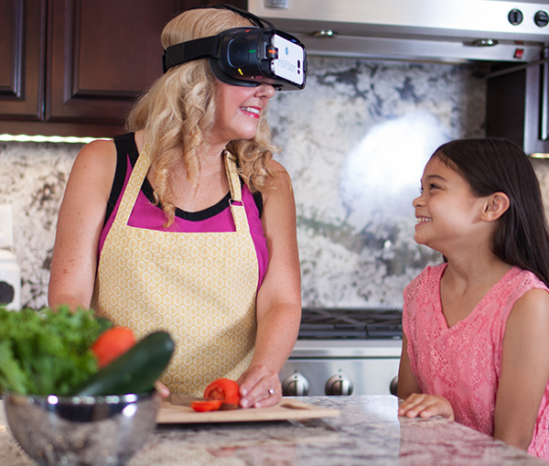
EXISTING DIVICES / ONGOING RESEARCH: G IRISVISION:
Electronic glasses, comprised of a smartphone mounted VR headset, which captures the images and offers a magnified view of the objects (within its field of view) to the viewer
Highly maneuverable magnification up to 14x
Boasts of a field of view up to 70-degrees, one of the broadest in the whole industry
Helps legally blind and visually hampered in performing a host of daily activities ranging from viewing live scenes and sports events to watching their favorite shows online or anything saved in its gallery
Patented “Bubble View” magnification feature designed to offer magnification within the bubble, without losing the overall context of the surrounding view
‘IrisVision Assistant’ to enable users operate this low vision device through voice commands, truly making it ‘hands-free’
‘Iris Reader’, another proprietary feature based on contemporary OCR techniques, through which the device can literally read you out the desired text
It was discovered by Frank werblin.
PRICE: ₹ 2,15,609.31.

Slide 5
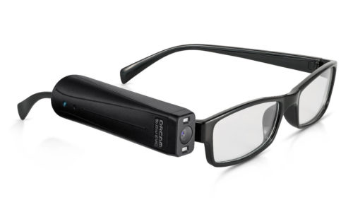
OrCAM MY EYE:
Text-to-speech is a technology that transforms written text into an audible form, that people can hear.
Text-to-speech technology can process words on a computer screen or a page and convert them into audio. Text-to-speech devices like the OrCam MyEye can help people with vision loss to read text independently.
There are two ways ,The first is a simple text reading feature. This feature will read text from the top of the page till the end of the page.
The second option is to use the smart text reading feature. This feature allows users to verbally instruct the device to find specific information in the text. For example, when reading the electric bill, you can instruct the device to find the “total amount due”.
It was discovered by prof.Amnon and Mr.Ziv.
PRICE: ₹ 3,28,700.70.

Slide 6
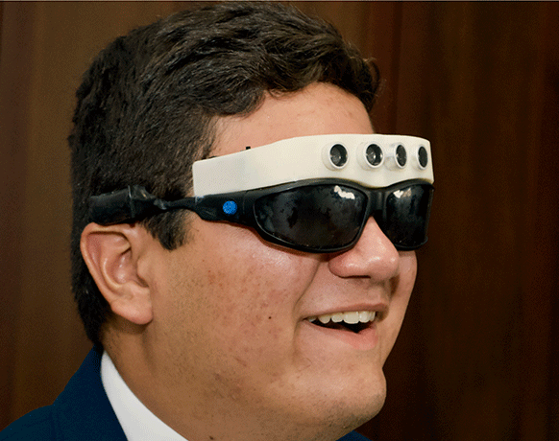
OBSTACLE DETECTION USING ULTRASONIC SENSORS:
This device controls the ultrasonic emitters (one over each eye). It directs these to regularly send out a brief pulse of sound.
Each pulse lasts about 10 millionths of a second. The sound waves travel out, then bounce back to the system’s receivers.
The computer calculates how long it takes for an echo to return. The quicker that is, the closer is the object off of which it bounced.
The teen mounted each of its two ultrasound emitters and two receivers in small holes on the device.
The computer beeps a warning when it detects an object within 1.3 meters (4 feet) of the wearer. That warning can be heard through earphones, such as those used to listen to musical devices. If an object is closer than 50 centimeters (20 inches), the glasses actually vibrate.
It was discovered by Axel toro vega.
PRICE:

Slide 7
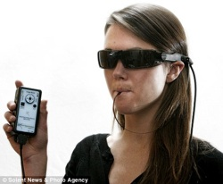
BRAIN PORT:
A small digital camera takes pictures of, say, a Stop sign, then turns that photographic information into raw digital pulses.
These pulses are then sent, via that sunglasses-looking wire thing, to your tongue.
Apparently the nerve endings on your tongue are such that your brain can interpret the pulses as images. A your mind’s eye sort of thing.
And while the technology won’t mean that blind people will be able to read, say, The Decline and Fall of The Roman Empire, it will permit them to “see” smaller things, like road signs and basic shapes.
Only about 20 hours of training is required for the user to become proficient. So, after just a few hours per day, users will be doing what they never thought possible: seeing!
It was developed by good folks at lighthouse international.
PRICE: ₹ 7,30,653.97.

Slide 8
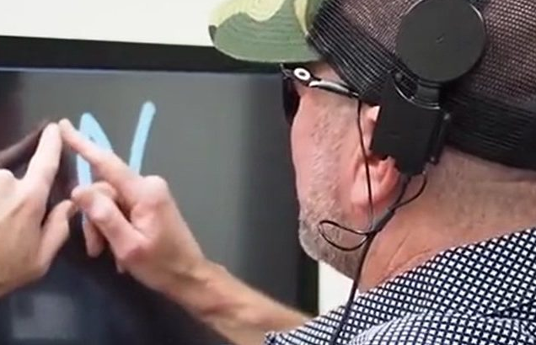
BRAIN IMPLANT:
The brain implant allows both sighted and blind participants to see the shape of letters. Such a development it’s only a step away to a “visual prosthetic” that would let blind people completely regain sight.
device that runs by skipping the eye and relying only on visual data from a camera right to electrodes implanted in the brain.
This development, however, still needs time to reach its final phases, as the brain is one of the most complex organs.
Main author of this research is Michael beauchamp.

Slide 9
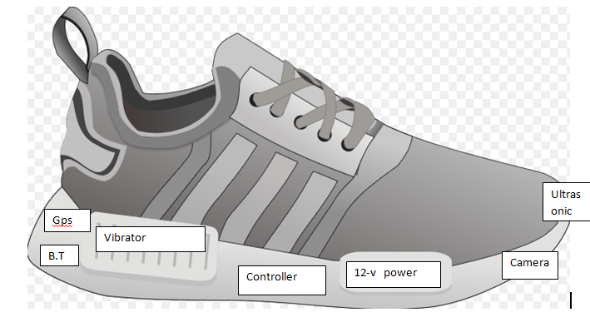
SMART SHOES :
This shoe will be enriched with various sensors with their numerous features which would help blind persons to make there way to destination.
Nowadays Android is a part of everyone’s life ,so in order to handle the stuffs present near them , that’s why we are connecting the android application to smart shoes which would be providing a hearing sensation to the person wearing that shoes which will inform them were the obstacle is, and providing them a secure way to destination.
PRICE:

Slide 10


BLOCK DIAGRAM:
Raspberry pi 3
model B
(Image classification +
Text extraction)
Battery pack
Speaker\
earphones
Raspberry pi
camera
Obstacle detection sensor
(ultrasonic sensor)

Slide 11
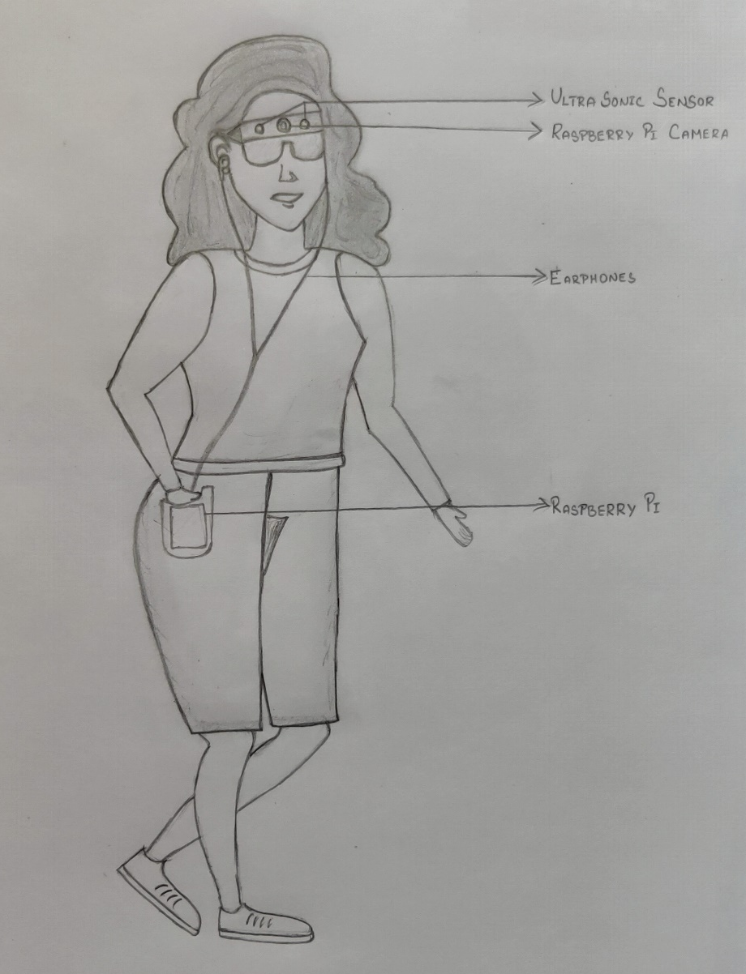
OVERVIWE OF THE BLOCK DIAGRAM:
The device consists of a Raspberry Pi 3B, speaker or earphones, Raspberry pi camera, Battery pack.
The raspberry pi camera captures image of their surrounding.
This picture is then processed by the Raspberry Pi and the audio output is heard through the speaker

Slide 12
COMPONENTS:
Raspberry pi module(microcontroller)
Raspberry pi camera
Ultrasonic sensor
Battery pack
Earphones/Speaker
Software used: Python

Slide 13
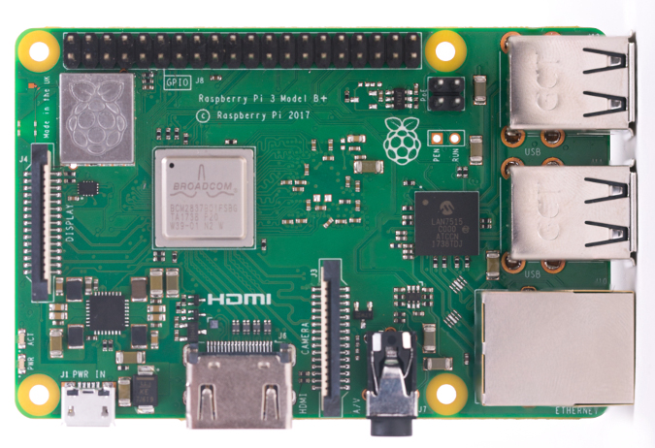
HARDWARE DISCRIPTION:
RASPBERRY PI:
The raspberry Pi is a small, low cost CPU which can be used with a monitor, keyboard and mouse to become an efficient, full-fledged computer.
The reason we chose Raspberry Pi micro-computer for our project is that, firstly, it is an easily available, low-cost device.
Raspberry Pi uses software which are either free or open source, which also makes it cost-effective.
The Raspberry Pi uses an SD card for storage and its small size also gives us the advantages of portability.

Slide 14
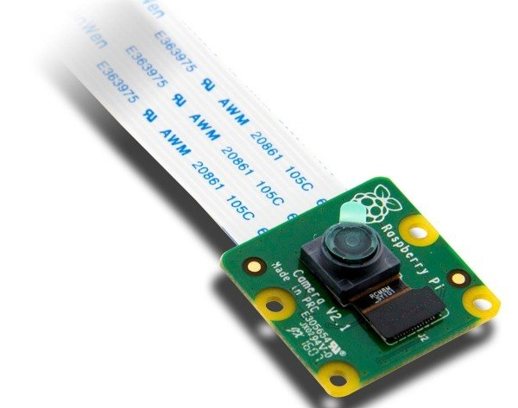
RASPBERRY PI CAMERA:
The raspberry pi camera used in our project will continuously captures images and sends to raspberry pi module for decoding
FEATURES:
5MP Omnivision 5647 Camera Module
Still Picture Resolution: 2592 x 1944
Video: Supports 1080p @ 30fps, 720p @ 60fps and 640x480p 60/90 Recording
15-pin MIPI Camera Serial Interface - Plugs Directly into the Raspberry Pi Board
Size: 20 x 25 x 9mm; Weight 3g
Fully Compatible with many Raspberry Pi cases

Slide 15
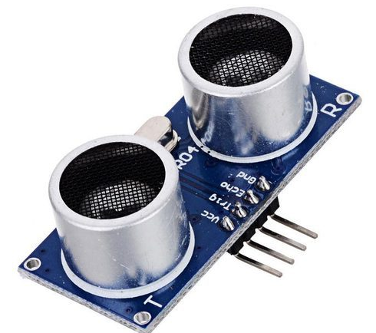
ULTRASONIC SENSOR:
An ultrasonic sensor is an instrument that measures the distance to an object using ultrasonic sound waves.
An ultrasonic sensor uses a transducer to send and receive ultrasonic pulses that relay back information about an object’s proximity.
The sensor determines the distance to a target by measuring time lapses between the sending and receiving of the ultrasonic pulse.

Slide 16
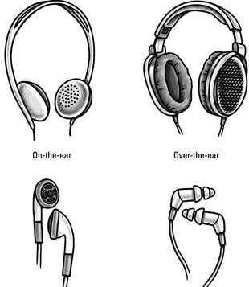
EARPHONES/SPEAKER:
The purpose of using earphones in our project, is to hear the audio output from the raspberry pi’s audio jack

Slide 17
SOFTWARE PROPERTIES:
LIBRARIES USED:
Python imaging library (PILLOW) for reading images.
Python tesseract (OCR tools)
Google text to speech (GTTS) for converting text to sound.

Slide 18
ALGORITHMS:
CONVERSION OF IMAGE TEXT TO SPEECH:
Extraction of text from image
Converting extracted text to sound
Extraction of text from image:
from PIL import Image.
import pytesseract.
create an image object of PIL library.
pass that image into pytesseract module.
the result of a Tesseract OCR run on the image to string.
Then finally print the text.

Slide 19
CONVERSION OF TEXT TO SPEECH:
Create an mp3 from a string of text
Ask the user for a text and create an mp3
Ask the user for a text file, extract the text and create an mp3

Slide 20
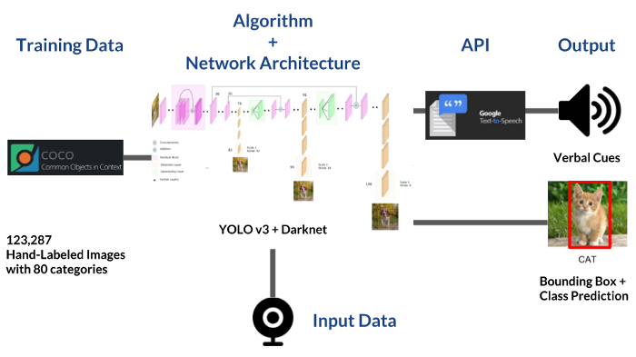
IMAGE CLASSIFICATION:

Slide 21
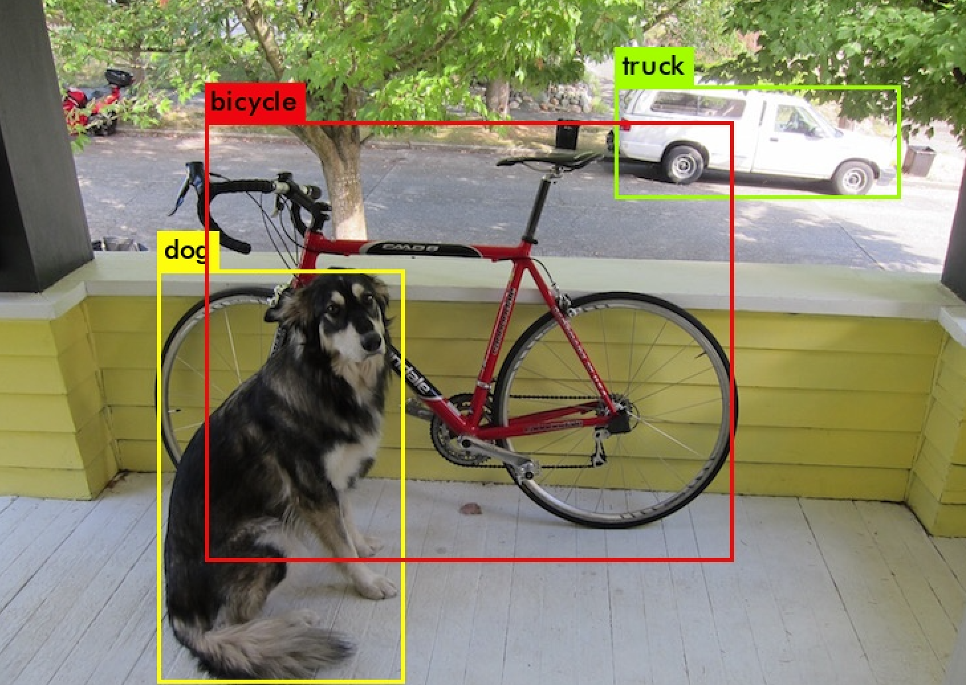
YOLOv3:
In our project we use YOLOv3 software for image classification.
YOLOv3 is a object detection system using a pre trained model.
The model is trained with the Common Objects In Context (COCO) dataset.
YOLOv3 is extremely fast and accurate.

Slide 22

FLOW CHART :
IMAGE CAPTURE
(RASPBERRY PI CAMERA)
IMAGE CLASSIFICATION
(YOLO V3+GTTS)
EXTRACTION OF TEXT
( OCR+GTTS)
BUS,BUILDING,
HUMAN etc…
SIGN BOARD,PRINTED TEXT etc….
VOICE OUTPUT
EARPHONES

Slide 23
ADVANTAGES:
Guides blind people.
Alerts through voice based message system.
Easily portable

Slide 24
REFERENCE:
https://towardsdatascience.com/object-detection-with-voice-feedback-yolo-v3-gtts-6ec732dca91
https://irisvision.com/devices-that-can-help-legally-blind-live-independently/
https://irisvision.com/
https://www.orcam.com/en/myreader2/
https://www.sciencenewsforstudents.org/blog/eureka-lab/new-eyewear-could-help-visually-impaired
https://techcrunch.com/2009/09/01/crazy-but-real-device-lets-blind-people-see-using-their-tongue/
https://innovate.mygov.in/innovation/smart-shoes-for-blind-person/
http://www.ijlret.com/Papers/Vol-3-issue-6/2-B2017160.pdf

Slide 25
THANK YOU

